Slide 1

Machine Learning and Artificial Intelligence
Instructors: Shurui Li, Daniel Ahn
Slides are adapted from previous year’s slides

Slide 2
Contents
What is Machine Learning?
Difference between ML and AI
Types of Learning
Applications
Elements of a ML problem
Linear regression

Slide 3
What is machine learning
“Field of study that gives computers the ability to learn without being explicitly programmed“ – Arthur Samuel
“How can we build computer systems that automatically improve with experience, and what are the fundamental laws that govern all learning processes?” – Tom Mitchell
Main idea: software/algorithms that can improve on a task based on data and previous experience. In other words: Let computers learn automatically without human intervention.

Slide 4
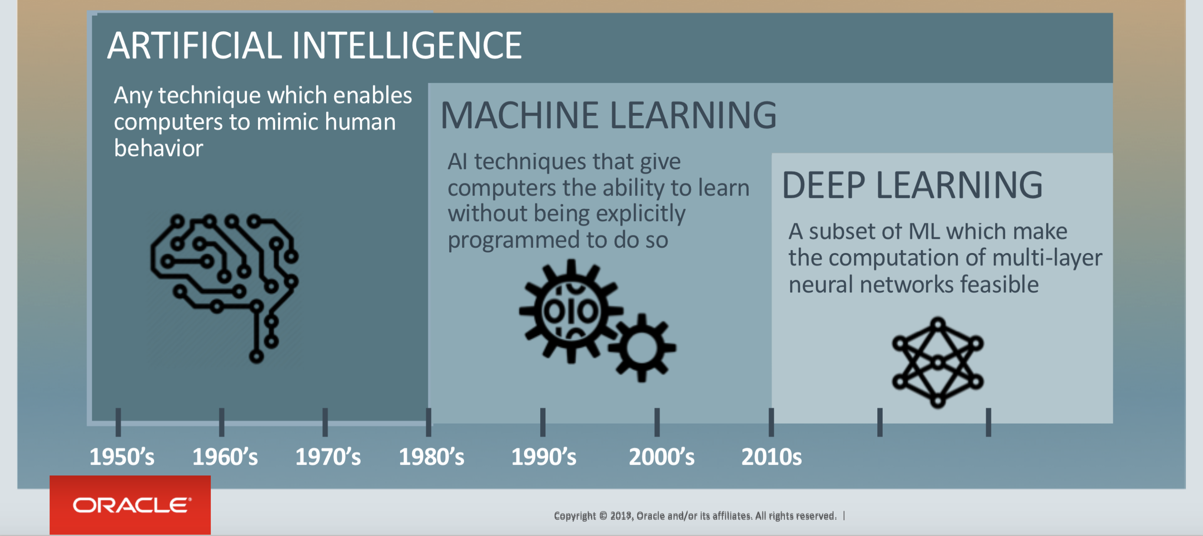
Difference between ML and AI

Slide 5
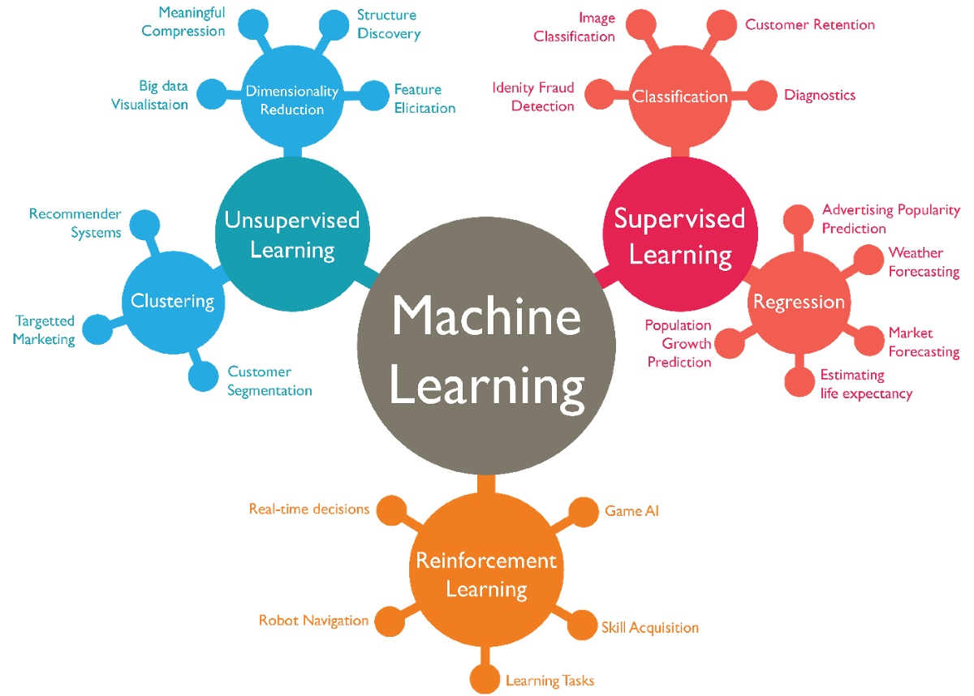
Source: dzone.com

Slide 6
Types of learning
1. Supervised Learning (task driven)
Training data set is well-labeled with the desired output.
Examples
Classification
Email spam detector
Facial recognition / thumbprint recognition
Speech recognition (Siri, Alexa, etc.)
Image classification
Prediction
Housing price estimate (Zillow)
Stock market

Slide 7
Types of learning
2. Unsupervised Learning (data driven)
No desired output label is given to the training data.
Can be used to find hidden patterns/structure in data.
Examples
Clustering
Shoppers into similar behaviors
Marketing strategies (ex: charities)
Recommendations (Netflix, Pandora, etc.)
Anomaly Detection
Credit card fraud / Banking fraud
Network Traffic Anomalies
Association Rule Learning
Learning a new language (without native translation)
Purchase hotdogs + ketchup = also purchase hotdog buns

Slide 8
Types of learning
3. Reinforcement Learning (environment driven)
Interacts with dynamic environment.
Receives positive and negative feedback.
Examples
Complex board games (chess, go, etc.)
Why not tic-tac-toe, connect-4, checkers, etc?
Video games
Self-driving cars / drones
Robotics
More efficient methods
Additional tasks

Slide 9
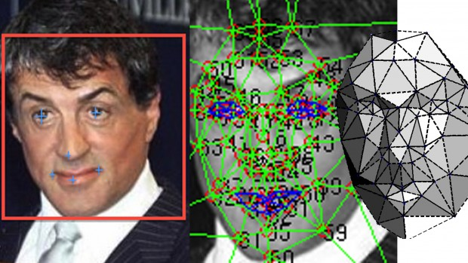
Applications of machine learning
One important application of machine learning is classification
Classify some data as belonging to a category
Several examples:
Spam email detection
Used in most email service providers
Data is the content of emails
Facial recognition
Used for identity identification
Commonly used in smart phones, security systems, etc.
Data is face images
Image recognition
Used to identify what is in the given picture
A wide range of applications, e.g., robots, drones, medical diagnosis, your phone’s gallery software
Data is just images

Slide 10
Application of machine learning
Another important application of machine learning is prediction (regression)
Predict the possible outputs (non-discrete) based on past experiences
Several examples
Recommendation systems
Used to recommend contents that users are interested in
Widely used in all kinds of apps & websites, e.g., YouTube, Tiktok, Amazon, Netflix, web browser, ads
Data is users’ history and behavior, e.g., browsing/shopping/watching history, past user feedback, time spent, or even scroll frequency!
Various forecasts
Predict possible results based on history
Examples: electricity usage prediction, company revenue prediction, winning probability of your favorite sport team, or even the stock price (well… probably not this one)
Data can be almost anything and is task and model dependent: e.g., injury status of a basketball team, or past revenue of a company

Slide 11
Some fun examples of robots
BRETT: Berkeley Robot for the Elimination of Tedious Tasks
https://www.youtube.com/watch?v=JeVppkoloXs
Not preprogrammed with knowledge how to accomplish specific tasks.
Starfish Walking Robot
https://www.youtube.com/watch?v=ehno85yI-sA
Taught itself to walk.
Google DeepMind AI taught itself how to walk.
https://www.youtube.com/watch?v=gn4nRCC9TwQ
https://deepmind.com/blog/producing-flexible-behaviours-simulated-environments/#gif-90
Boston Dynamics
https://www.youtube.com/watch?v=4PaTWufUqqU

Slide 12
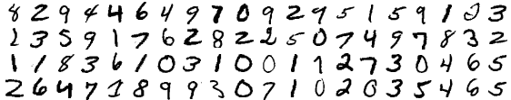
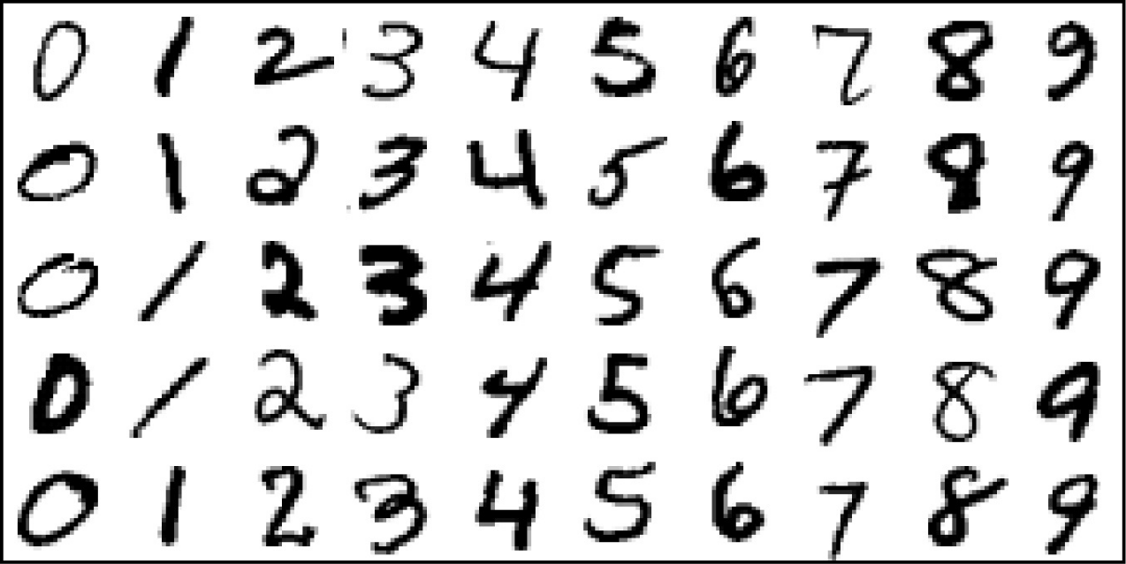
Elements of a ML problem: inputs
Let’s start with supervised learning.
First, we get some inputs.
Lots of equivalent terminology from different fields. Also called:
Predictors
Independent variables
Features
Inputs have some influence on outputs. The goal is to use inputs to predict the outputs.
Example: identifying handwritten digits.
Our algorithm is now trained, apply it to the test set:
Inputs: Training Set
Corresponding Labels:
8 2 9 4 4 6 4 9 …

Slide 13
Data is the key!
The input used for training the algorithm (commonly called data) is extremely important for good learning results
It is as important as the learning model/algorithm design, if not more important to
No algorithm can learn anything useful from incorrect or invalid data
Learning results strongly depends on the number and quality of data
Learning algorithm choice also depends on the amount of training data
<50: get more data!
50-10K: non deep learning methods. e.g., regression, SVM, random forest, etc.
>10k: go for deep learning (neural networks) for better results
Lots of data pre-processing and filtering techniques to improve the quality of data

Slide 14
Elements of a ML problem: outputs
Now let’s talk about outputs
As we saw, the outputs vary with the type of problem
Can be quantitative (a number)
For example, predicting ad revenues
Can be qualitative (no numerical relationship between the outputs)
Our classification tasks.
Going back to our classification/regression idea:
Predicting quantitative outputs: regression
Predicting qualitative outputs: classification
Another option is “ordered categorical”
For example, “small, medium, large”. There’s an order, but it’s not numerically set (large-medium isn’t necessarily the same as medium-small.)

Slide 15
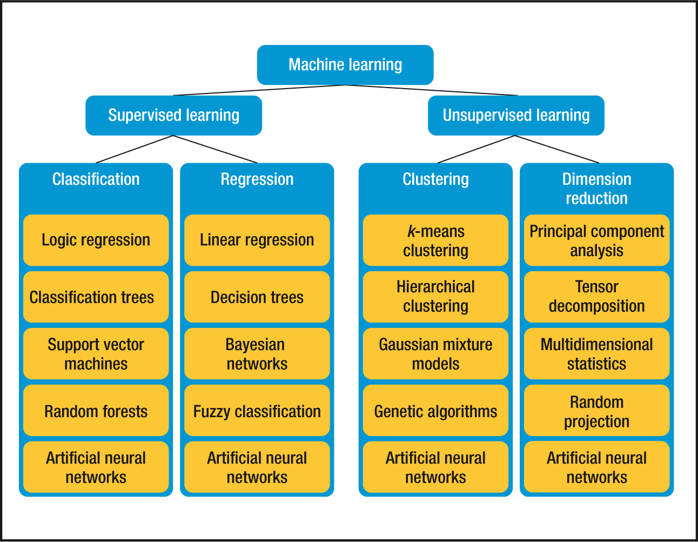
Various machine learning algorithms
How to choose the best approach for a particular problem?
A: It’s a hard one and can be very complicated, but there’s still some rule of thumbs

Slide 16


Slide 17
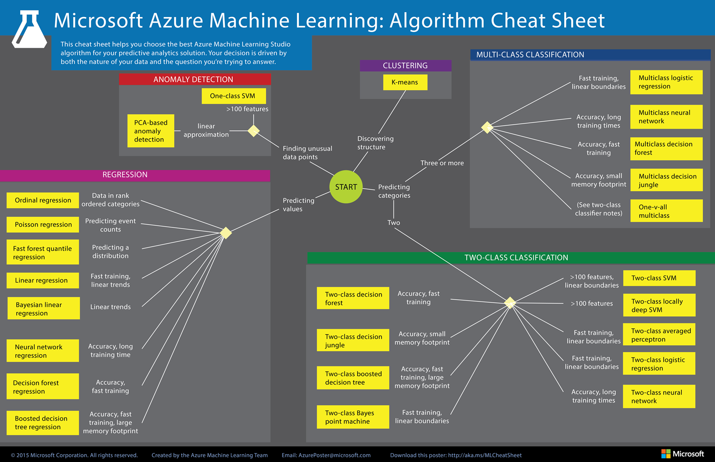

Slide 18
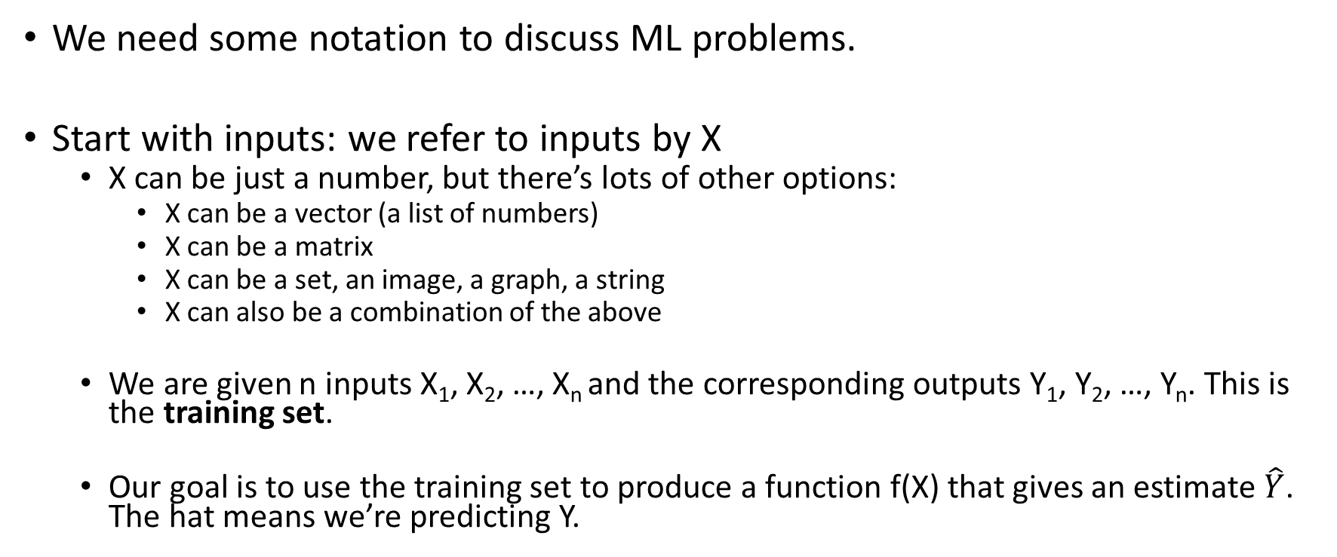
Elements of a ML problem: notation
We need some notation to discuss ML problems.
Start with inputs: we refer to inputs by X
X can be just a number, but there’s lots of other options:
X can be a vector (a list of numbers)
X can be a matrix
X can be a set, an image, a graph, a string
X can also be a combination of the above
We are given n inputs X₁, X₂, …, X_{n} and the corresponding outputs Y₁, Y₂, …, Y_{n}. This is the training set.
Our goal is to use the training set to produce a function f(X) that gives an estimate $\hat{Y}$. The hat means we’re predicting Y.

Slide 19
Linear prediction
Simplest method for regression tasks, but also widely used
Essentially ‘line fitting’

Slide 20
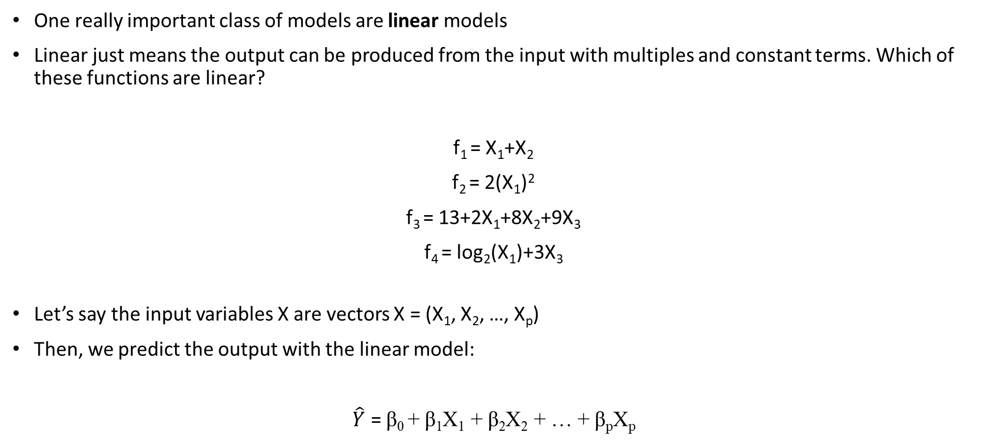
Linear Prediction
One really important class of models are linear models
Linear just means the output can be produced from the input with multiples and constant terms. Which of these functions are linear?
f₁ = X₁+X₂
f₂ = 2(X₁)²
f₃ = 13+2X₁+8X₂+9X₃
f₄ = log₂(X₁)+3X₃
Let’s say the input variables X are vectors X = (X₁, X₂, …, X_{p})
Then, we predict the output with the linear model:
$\hat{Y}$ = β₀ + β₁X₁ + β₂X₂ + … + β_{p}X_{p}

Slide 21
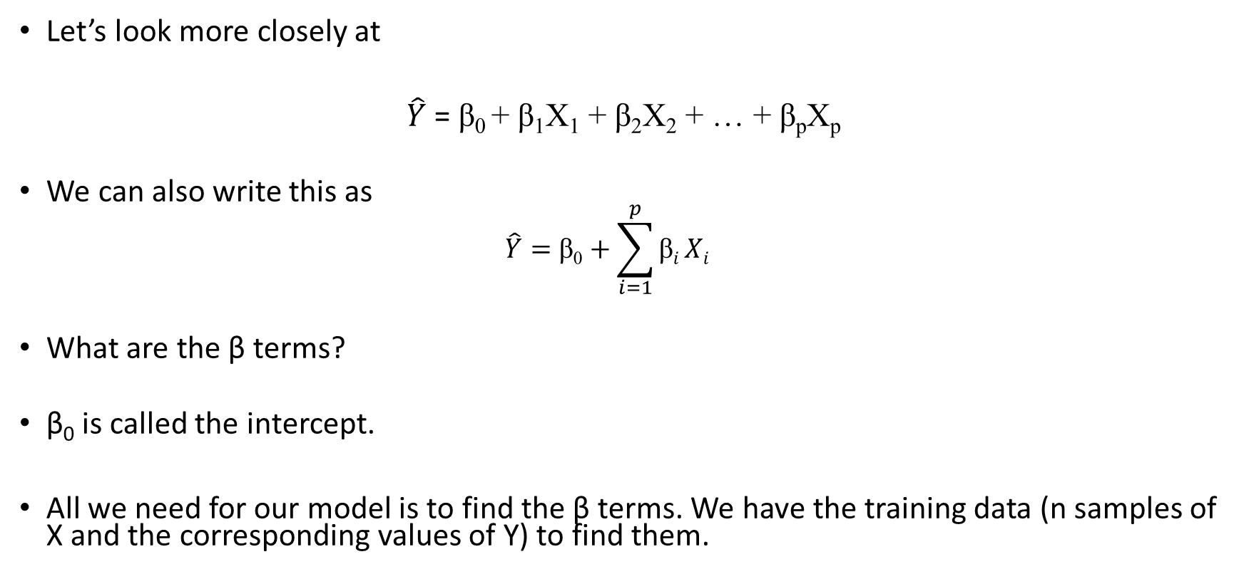
Linear Prediction
Let’s look more closely at
$\hat{Y}$ = β₀ + β₁X₁ + β₂X₂ + … + β_{p}X_{p}
We can also write this as
$$\hat{Y}=\text{β}\text{0}+\sum_{i=1}^{p}{\text{β}i}Xi$$
What are the β terms?
β₀ is called the intercept.
All we need for our model is to find the β terms. We have the training data (n samples of X and the corresponding values of Y) to find them.

Slide 22
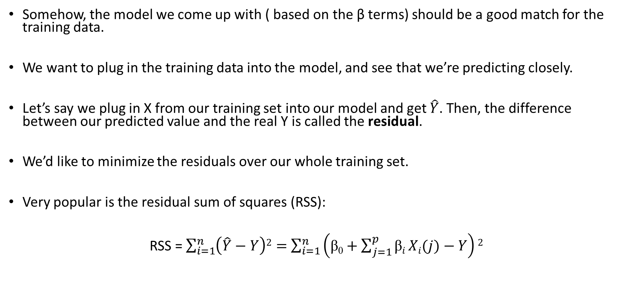
Linear Prediction
Somehow, the model we come up with ( based on the β terms) should be a good match for the training data.
We want to plug in the training data into the model, and see that we’re predicting closely.
Let’s say we plug in X from our training set into our model and get $\hat{Y}$. Then, the difference between our predicted value and the real Y is called the residual.
We’d like to minimize the residuals over our whole training set.
Very popular is the residual sum of squares (RSS):
RSS = $\sum_{i=1}^{n}{\left(\hat{Y}−Y\right)2}=$ $\sum_{i=1}^{n}{\left(\text{β}\text{0}+\sum_{j=1}^{p}{\text{β}i}Xi(j)−Y\right)2}$

Slide 23
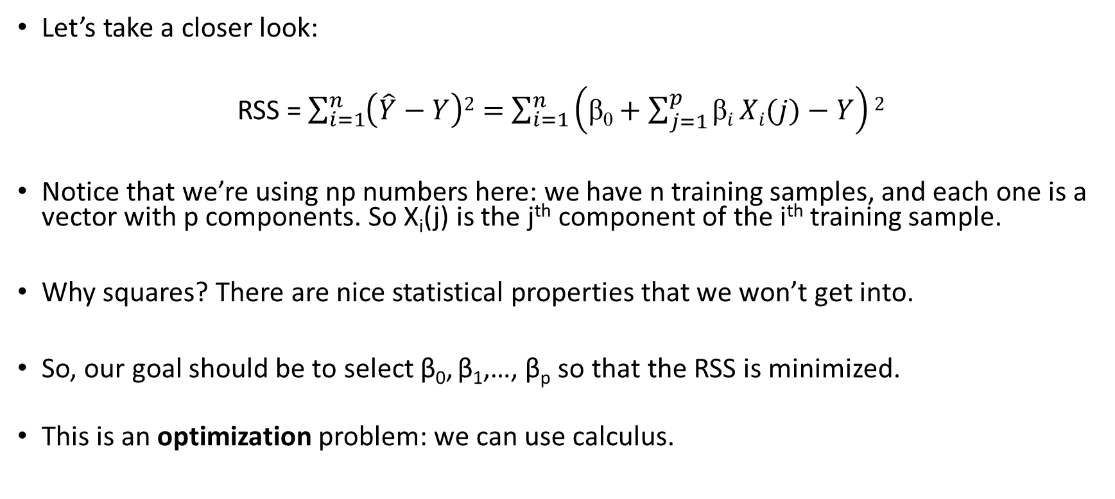
Linear Prediction
Let’s take a closer look:
RSS = $\sum_{i=1}^{n}{\left(\hat{Y}−Y\right)2}=$ $\sum_{i=1}^{n}{\left(\text{β}\text{0}+\sum_{j=1}^{p}{\text{β}i}Xi(j)−Y\right)2}$
Notice that we’re using np numbers here: we have n training samples, and each one is a vector with p components. So X_{i}(j) is the j^{th} component of the i^{th} training sample.
Why squares? There are nice statistical properties that we won’t get into.
So, our goal should be to select β₀, β₁,…, β_{p} so that the RSS is minimized.
This is an optimization problem: we can use calculus.

Slide 24
Little bit of matrices/calculus
OK, so the RSS above looked scary. Let’s use some vectors to make it look nice:
Make Y a vector (y₁,…,y_{N})^{T}. Then, make X a matrix that is N x p. Also, set β = (β₀, β₁,…, β_{p})^{T}. Then, we can write the RSS above in the simple notation:
RSS = (y-Xβ)^{T}(y-Xβ)
Since we want to minimize the RSS, we can take the derivative and set it to 0. We get
X^{T}(y-Xβ)=0
Solving,
β =(X^{T}X)⁻¹X^{T}y

Slide 25
What does this actually do?
Let’s look at a classification example.
We want to define a linear boundary that selects whether a class of points is orange or blue:
Our linear function is just a line in the XY plane; if a point is above it, we classify it as orange. If it’s below, we classify it as blue.

Slide 26
What does this actually do?
Our linear function is just a line in the XY plane; if a point is above it, we classify it as orange. If it’s below, we classify it as blue.
The slope of the line β is selected to minimize the RSS of incorrect classification among all the points. We make orange 0, blue 1, so the residuals are always 0 or 1.

Slide 27
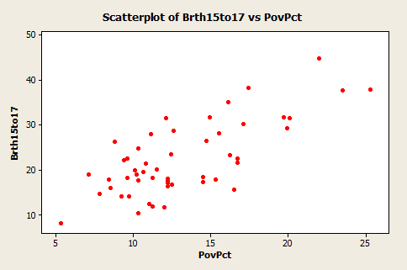
A regression example
Example: Teen birth rate and poverty level data
Use linear regression to fit the line!

Slide 28
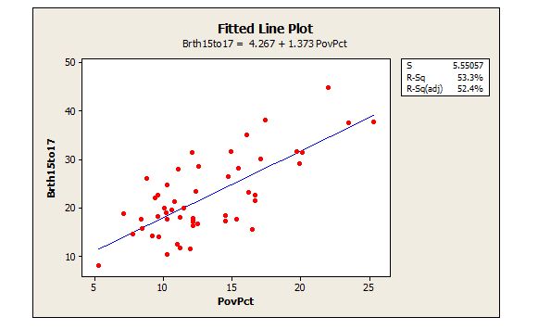
A regression example
After fitting the line that minimizes the RSS of training data, we can predict the birth rate given the poverty rate

Slide 29
Another example:
Let’s look at a case where we’re predicting outputs Y from X₁ and X₂.
Our model is a plane (linear!). The training data is the points in red. The slope of the plane is chosen to minimize the distance of the plane to all the red dots.
Harder to visualize for more than 2 dimensions.

Slide 30
Drawback of linear prediction
Not all relationship are linear in real life (probably most of them are not)
Linear prediction on its own works poorly on data with high dimensions (some information are less important than others)
Need other learning algorithms for those data, e.g. , dimension reduction methods, random forest, neural networks

